Slide 1

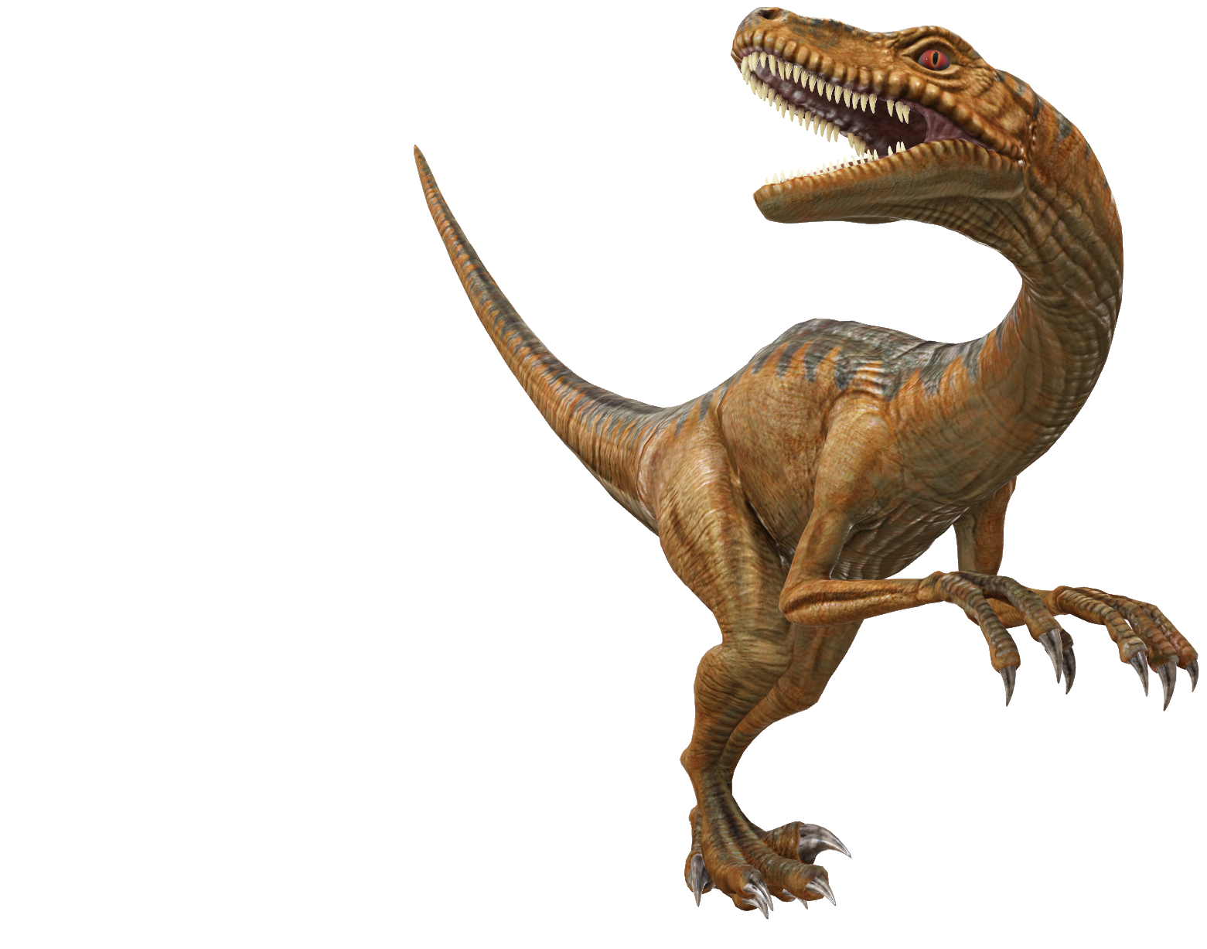
Jurassic Park
Expense Reimbursement
System (ERS)
API
By: Reba Pipes
Notes:
Jurassic Park ERS API (Project 0)

Slide 2

Jurassic Park Models
User - keeps track of user information
{
userId: number, // primary key
username: string, // not null, unique
password: string, // not null
firstName: string, // not null
lastName: string, // not null
email: string, // not null
role: Role // not null
}
Role - tracks what permissions a user has
{
roleId: number, // primary key
role: string // not null, unique
}
Notes:
User & Role Model

Slide 3
Jurassic Park Models
Reimbursement - represents a single reimbursement that an employee would submit
{
reimbursementId: number, // primary key
author: number, // foreign key -> User, not null
amount: number, // not null
dateSubmitted: number, // not null
dateResolved: number, // not null
description: string, // not null
resolver: number, // foreign key -> User
status: number, // foreign key -> ReimbursementStatus, not null
type: number // foreign key -> ReimbursementType
}
Notes:
Reimbursement Model

Slide 4
Jurassic Park Models
ReimbursementStatus - tracks the status of reimbursements (pending, approved, denied)
{
statusId: number, // primary key
status: string // not null, unique
}
ReimbursementType - tracks what permissions a user has
{
typeId: number, // primary key
type: string, // not null, unique
}
Notes:
ReimbursementStatus & ReimbursementType Model

Slide 5
Src
DAOS
User
Reimbursement
DTOS
Reimbursement
Errors
Middleware
Models
Routers
Utils
Project Index
DAO Index
User
Authorization
Authentication
HTTP
Invalid Credentials
Reimbursement Not Found
User Input
User Not Found
Authentication
Authorization
Reimbursement Input
Logging
Session
Reimbursement
Reimbursement Author
Reimbursement DTO Converter
Reimbursement Status
Reimbursement Type
Role
User
Reimbursement Status
Reimbursement
User
User DTO Converter
Notes:
Project 0 Structure

Slide 6
Jurassic Park ERS API
Demo Outline
User Login
Find Users
Find Users by Id
Update User
Find Reimbursements by Status
Find Reimbursements by User
Submit Reimbursement
Update Reimbursement
Notes:
Demo Outline

Slide 7
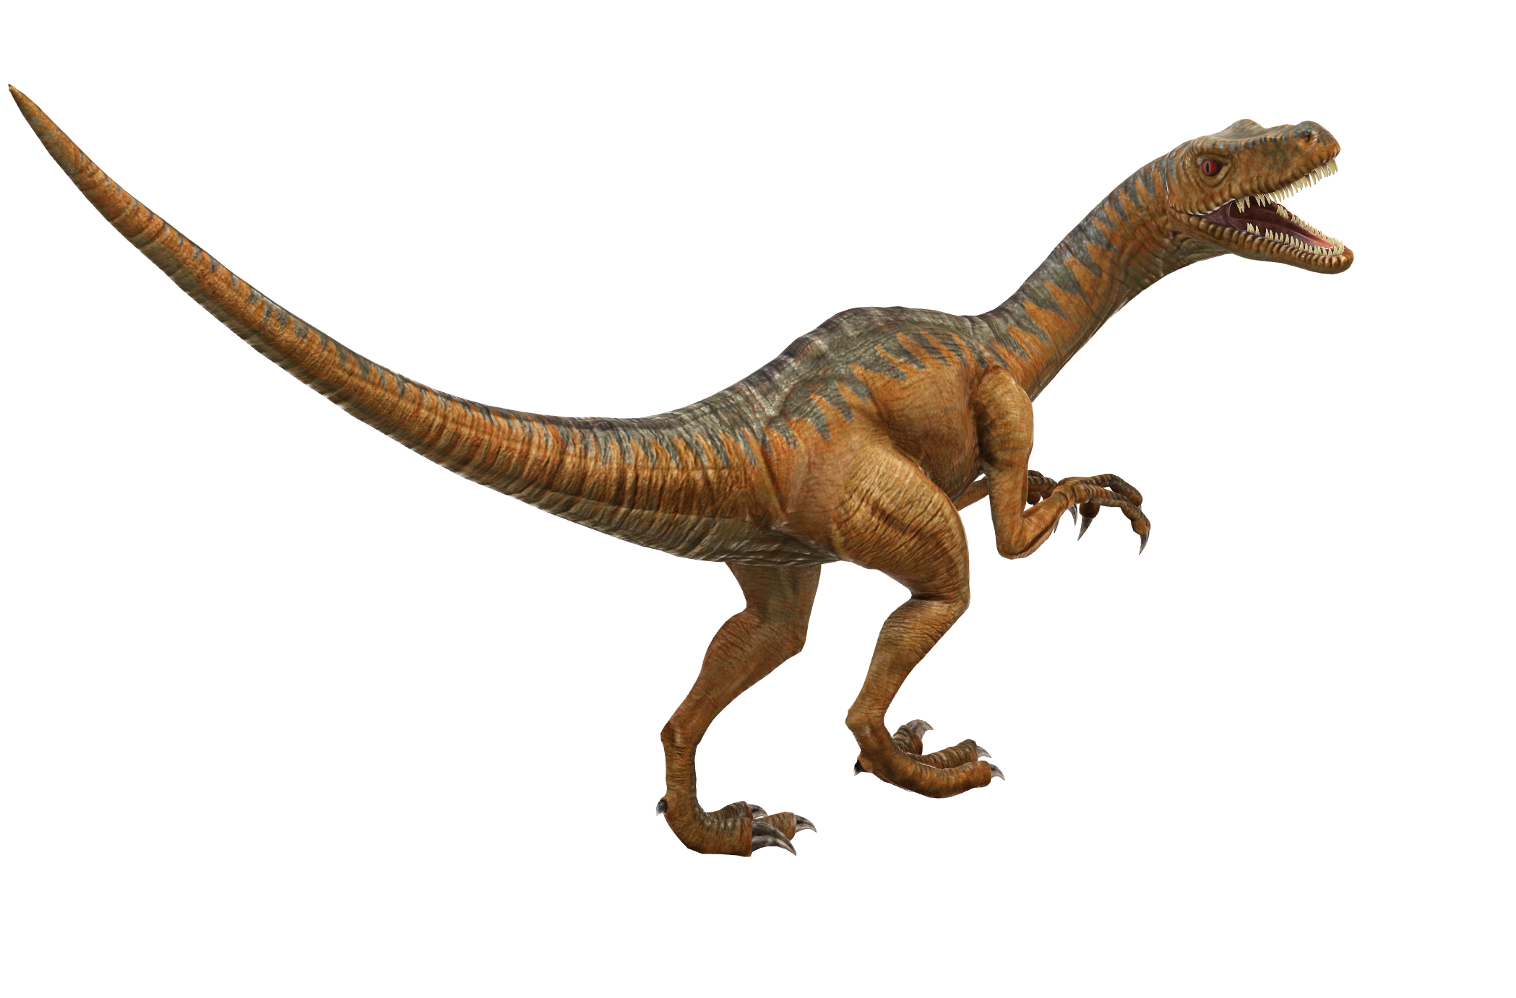
Demo Time!
Notes:
Demo Time!

